Slide 1
Architectural Acoustics
Week 5: Building Acoustics
Lecture B.1
Jieun Yang (j.yang3@tue.nl) Assistant professor, Building Acoustics group

Slide 2
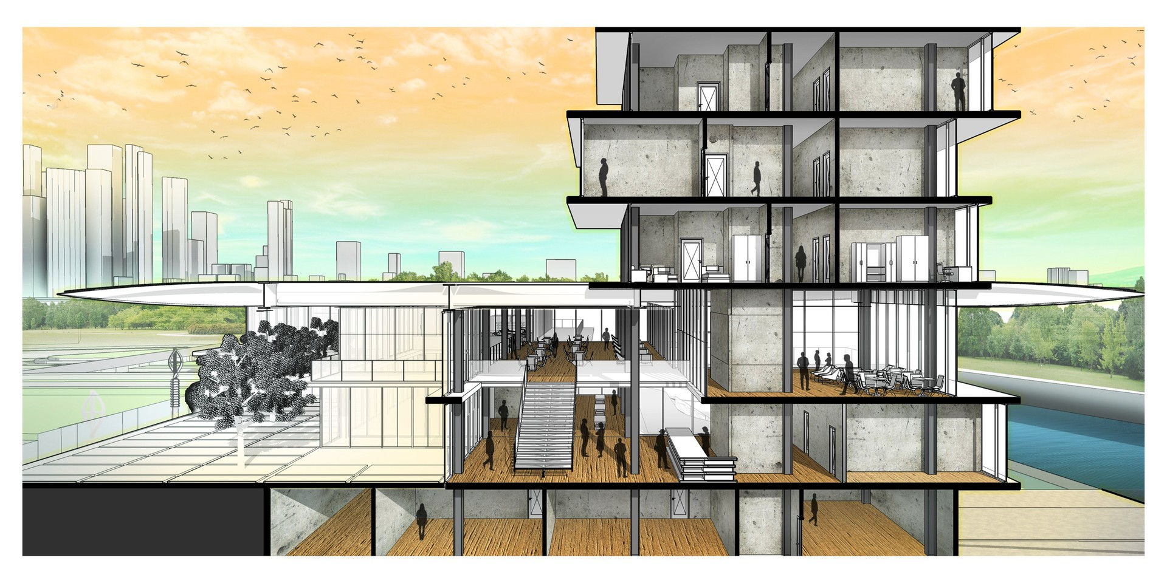
Introduction: Building Acoustics
Architectural Acoustics
Fundamentals of Acoustics
Environmental Acoustics
Building Acoustics
Room Acoustics
→ Outdoor environment
→ Indoor environment
https://images.app.goo.gl/47SBr2x1Vzd8stFf8

Slide 3
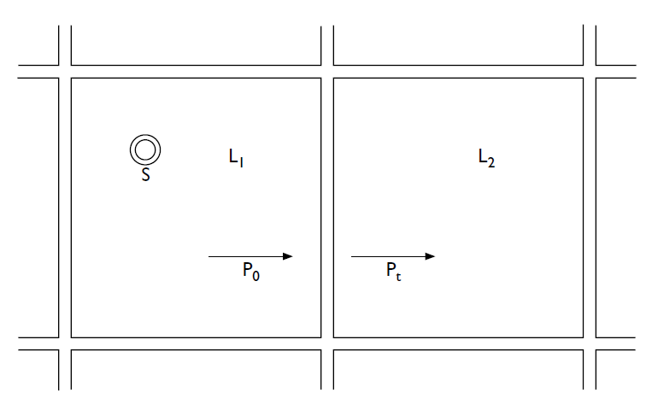
Introduction: Building Acoustics
Lecture B.1 (Chapter 10)
Lecture B.2 (Chapter 14)
Lecture B.3 (Vigran Chapter 9)
Sound waves in isotropic solids
Building Acoustics
Sound reduction through multiple surfaces and ducts
Flanking sound transmission

Slide 4
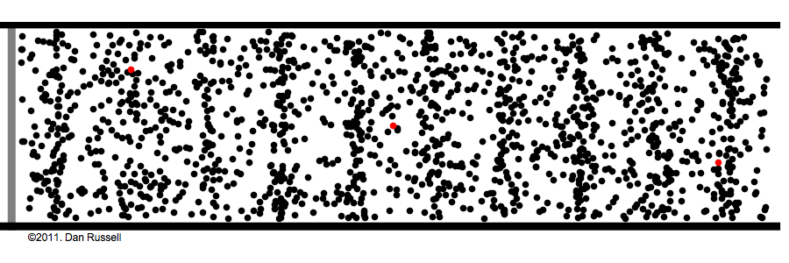
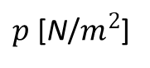
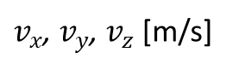
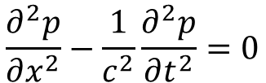
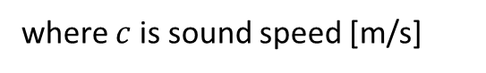
Chapter 10. Sound waves in isotropic solids
[Recall] Wave propagation in air
Consider 1-D propagation along x-axis:
$$\frac{∂^{2}p}{∂x^{2}}−\frac{1}{c^{2}}\frac{∂^{2}p}{∂t^{2}}=0$$
where $c$ is sound speed [m/s]
Motion of particles in direction of
wave propagation (longitudinal wave)
Pressure
$p$ [N/$m^{2}$]
Velocity components
(in cartesian coordinate)
$v_{x}$, $v_{y}$, $v_{z}$ [m/s]

Slide 5
Chapter 10. Sound waves in isotropic solids
Q: Why only longitudinal waves in fluid media?
Transverse / shear
Gas
(e.g. air)
Liquid
(e.g. water)
Solid
(e.g. metal, glass, wood)
Fluids
→ Fluids do not have enough resistive force (or restoring force) to generate transverse waves

Slide 6
Chapter 10. Sound waves in isotropic solids
Waves in unbounded solids
Waves in plates and bars
Waves in elastic medium → Elastic waves

Slide 7



Chapter 10. Sound waves in isotropic solids
Q: Why do we learn this?
Floor/Ceiling
Source room
Wall
Receiving room
Source room
Receiving room
Air → solid (wall) → air
Solid (floor) → air

Slide 8
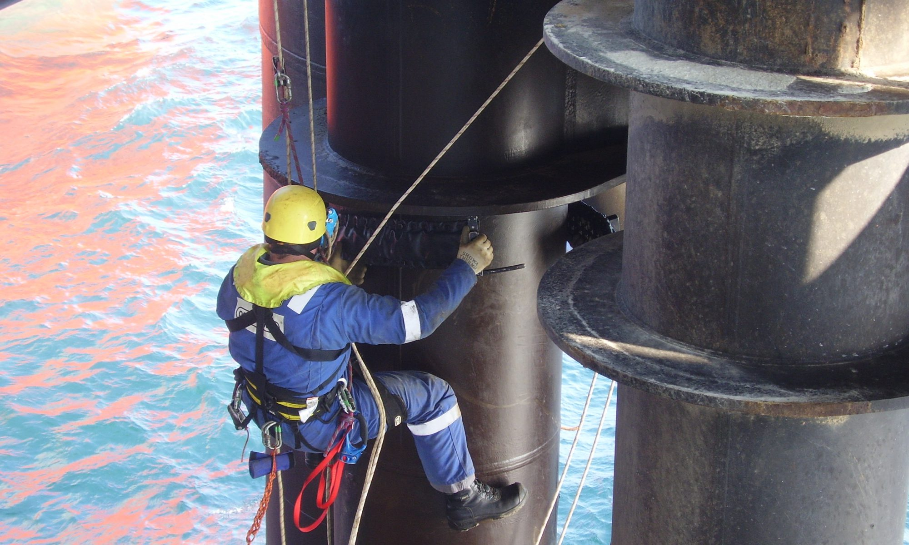
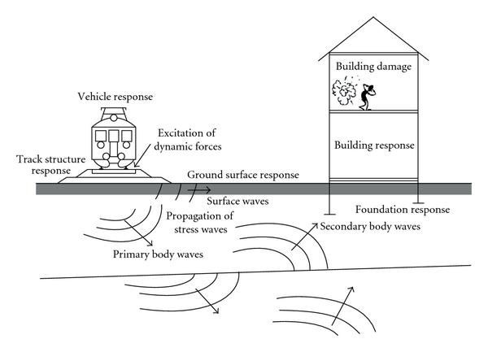
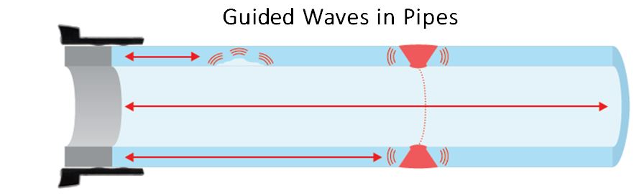
Chapter 10. Sound waves in isotropic solids
Q: Why do we learn this?
https://images.app.goo.gl/bHcEPZfFk5vtdsMY9
https://images.app.goo.gl/fAXyfWpFLH5nYQX27

Slide 9
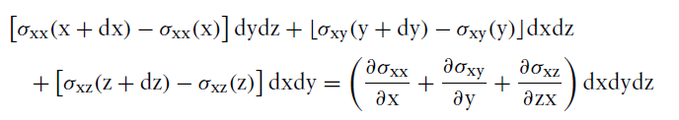
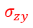
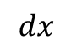
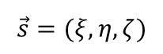
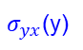
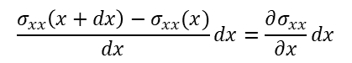
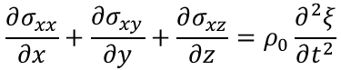
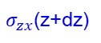
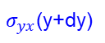
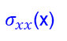
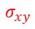
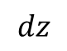

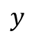
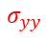
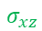
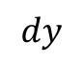
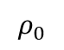
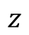
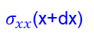
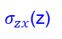
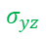
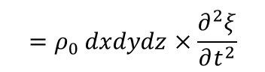
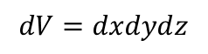
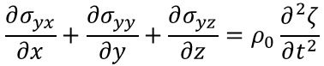
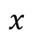
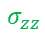
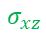
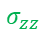

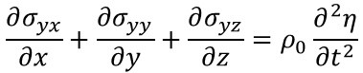
10.1 Sound waves in unbounded solids
Wave propagation in isotropic solids
Chapter 3.3.2 Isotropic solids
$$\frac{σ_{xx}\left(x+dx\right)−σ_{xx}(x)}{dx}dx=\frac{∂σ_{xx}}{∂x}dx$$
Force equilibrium (x direction):
$$z$$
$$y$$
$$σ_{zz}$$
$$σ_{zy}$$
$σ_{zx}$(z+dz)
$$x$$
$$σ_{yz}$$
$$σ_{yy}$$
$$σ_{xy}$$
$$dz$$
$σ_{xx}$(x)
$$σ_{xz}$$
$σ_{yx}$(y+dy)
$$=ρ_{0} dxdydz×\frac{∂^{2}ξ}{∂t^{2}}$$
$$σ_{xy}$$
$σ_{yx}$(y)
$σ_{xx}$(x+dx)
$$=\left(mass\right)×(acceleration)$$
$$σ_{xz}$$
$$σ_{yy}$$
$$σ_{yz}$$
$σ_{zx}$(z)
$$\frac{∂σ_{xx}}{∂x}+\frac{∂σ_{xy}}{∂y}+\frac{∂σ_{xz}}{∂z}=ρ_{0}\frac{∂^{2}ξ}{∂t^{2}}$$
(x direction)
$$σ_{zy}$$
$$dy$$
$$σ_{zz}$$
$$dx$$
$$\frac{∂σ_{yx}}{∂x}+\frac{∂σ_{yy}}{∂y}+\frac{∂σ_{yz}}{∂z}=ρ_{0}\frac{∂^{2}η}{∂t^{2}}$$
(y direction)
$$dV=dxdydz$$
$$\vec{s}=(ξ,η,ζ)$$
Displacement vector
$$\frac{∂σ_{yx}}{∂x}+\frac{∂σ_{yy}}{∂y}+\frac{∂σ_{yz}}{∂z}=ρ_{0}\frac{∂^{2}ζ}{∂t^{2}}$$
(z direction)
$$ρ_{0}$$
Mass density [$kg/m^{3}$]

Slide 10
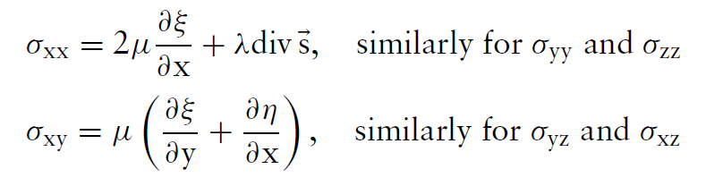
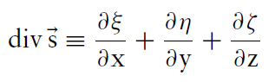
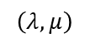
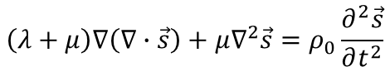
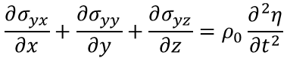
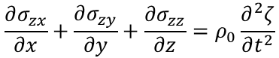
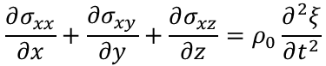
10.1 Sound waves in unbounded solids
Wave propagation in isotropic solids
$$\frac{∂σ_{xx}}{∂x}+\frac{∂σ_{xy}}{∂y}+\frac{∂σ_{xz}}{∂z}=ρ_{0}\frac{∂^{2}ξ}{∂t^{2}}$$
(x direction)
$$\frac{∂}{∂x}\left(2μ\frac{∂ξ}{∂x}+λ\left(\frac{∂ξ}{∂x}+\frac{∂η}{∂y}+\frac{∂ζ}{∂z}\right)\right)+\frac{∂}{∂y}μ\left(\frac{∂ξ}{∂y}+\frac{∂η}{∂x}\right)+\frac{∂}{∂z}μ\left(\frac{∂ξ}{∂z}+\frac{∂ζ}{∂x}\right)=ρ_{0}\frac{∂^{2}ξ}{∂t^{2}}$$
$$\frac{∂σ_{yx}}{∂x}+\frac{∂σ_{yy}}{∂y}+\frac{∂σ_{yz}}{∂z}=ρ_{0}\frac{∂^{2}η}{∂t^{2}}$$
(y direction)
$$\left(λ+μ\right)\left(\frac{∂^{2}ξ}{∂x^{2}}+\frac{∂^{2}η}{∂x∂y}+\frac{∂^{2}ζ}{∂x∂z}\right)+μ\left(\frac{∂^{2}ξ}{∂x^{2}}+\frac{∂^{2}ξ}{∂y^{2}}+\frac{∂^{2}ξ}{∂z^{2}}\right)=ρ_{0}\frac{∂^{2}ξ}{∂t^{2}}$$
(x direction)
$$\frac{∂σ_{zx}}{∂x}+\frac{∂σ_{zy}}{∂y}+\frac{∂σ_{zz}}{∂z}=ρ_{0}\frac{∂^{2}ζ}{∂t^{2}}$$
(z direction)
Similarly,
For homogeneous, isotropic, elastic solids,
$$\left(λ+μ\right)\left(\frac{∂^{2}ξ}{∂x∂y}+\frac{∂^{2}η}{∂y^{2}}+\frac{∂^{2}ζ}{∂y∂z}\right)+μ\left(\frac{∂^{2}η}{∂x^{2}}+\frac{∂^{2}η}{∂y^{2}}+\frac{∂^{2}η}{∂z^{2}}\right)=ρ_{0}\frac{∂^{2}η}{∂t^{2}}$$
(y direction)
$$\left(λ+μ\right)\left(\frac{∂^{2}ξ}{∂x∂y}+\frac{∂^{2}η}{∂x∂z}+\frac{∂^{2}ζ}{∂z^{2}}\right)+μ \left(\frac{∂^{2}ζ}{∂x^{2}}+\frac{∂^{2}ζ}{∂y^{2}}+\frac{∂^{2}ζ}{∂z^{2}}\right)=ρ_{0}\frac{∂^{2}ζ}{∂t^{2}}$$
(z direction)
→
$$\left(λ+μ\right)∇\left(∇∙\vec{s}\right)+μ∇^{2}\vec{s}=ρ_{0}\frac{∂^{2}\vec{s}}{∂t^{2}}$$
where
$$\left(λ,μ\right)$$
Lame constants
Wave equation in isotropic elastic solid

Slide 11
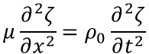
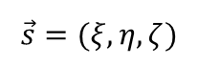
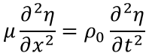
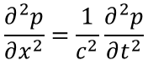





10.1 Sound waves in unbounded solids
Wave propagation in isotropic solids
Plane waves propagating in the x-direction
Equation (10.1)
$$\left(λ+μ\right)\left(\frac{∂^{2}ξ}{∂x^{2}}+\frac{∂^{2}η}{∂x∂y}+\frac{∂^{2}ζ}{∂x∂z}\right)+μ\left(\frac{∂^{2}ξ}{∂x^{2}}+\frac{∂^{2}ξ}{∂y^{2}}+\frac{∂^{2}ξ}{∂z^{2}}\right)=ρ_{0}\frac{∂^{2}ξ}{∂t^{2}}$$
→
$$\left(2μ+λ\right)\frac{∂^{2}ξ}{∂x^{2}}=ρ_{0}\frac{∂^{2}ξ}{∂t^{2}}$$
$$z$$
T
$$y$$
$$\left(λ+μ\right)\left(\frac{∂^{2}ξ}{∂x∂y}+\frac{∂^{2}η}{∂y^{2}}+\frac{∂^{2}ζ}{∂y∂z}\right)+μ\left(\frac{∂^{2}η}{∂x^{2}}+\frac{∂^{2}η}{∂y^{2}}+\frac{∂^{2}η}{∂z^{2}}\right)=ρ_{0}\frac{∂^{2}η}{∂t^{2}}$$
→
$$μ\frac{∂^{2}η}{∂x^{2}}=ρ_{0}\frac{∂^{2}η}{∂t^{2}}$$
T
L
$$x$$
$$\left(λ+μ\right)\left(\frac{∂^{2}ξ}{∂x∂y}+\frac{∂^{2}η}{∂x∂z}+\frac{∂^{2}ζ}{∂z^{2}}\right)+μ \left(\frac{∂^{2}ζ}{∂x^{2}}+\frac{∂^{2}ζ}{∂y^{2}}+\frac{∂^{2}ζ}{∂z^{2}}\right)=ρ_{0}\frac{∂^{2}ζ}{∂t^{2}}$$
→
$$μ\frac{∂^{2}ζ}{∂x^{2}}=ρ_{0}\frac{∂^{2}ζ}{∂t^{2}}$$
wave propagating direction
Plane waves propagating in the x-direction in air
$$\frac{∂^{2}p}{∂x^{2}}=\frac{1}{c^{2}}\frac{∂^{2}p}{∂t^{2}}$$
$$\vec{s}=(ξ,η,ζ)$$
Displacement vector
$$ρ_{0}$$
Mass density [$kg/m^{3}$]

Slide 12






10.1 Sound waves in unbounded solids
Wave propagation in isotropic solids
One longitudinal wave (compressional wave)
Two transverse waves (shear waves)
→ Motion of particles in direction of wave propagation
→ Motion of particles perpendicular to wave propagation
$$\left(2μ+λ\right)\frac{∂^{2}ξ}{∂x^{2}}=ρ_{0}\frac{∂^{2}ξ}{∂t^{2}}$$
$$μ\frac{∂^{2}η}{∂x^{2}}=ρ_{0}\frac{∂^{2}η}{∂t^{2}}$$
$$μ\frac{∂^{2}ζ}{∂z^{2}}=ρ_{0}\frac{∂^{2}ζ}{∂t^{2}}$$
z
z
z
propagating direction
y
T
x
propagating direction
y
x
y
x
propagating direction
L
T
Animations from https://nojigon.webs.upv.es/simulations_waves.php

Slide 13







10.1 Sound waves in unbounded solids
Wave speeds
Sound velocity in air: 343 [m/s]
Wave equation in air
Longitudinal wave speed
Wave equations in solids
Transverse wave speed
$$\frac{∂^{2}ξ}{∂x^{2}}=\frac{1}{c_{L}^{2}}\frac{∂^{2}ξ}{∂t^{2}}$$
$$\frac{∂^{2}η}{∂x^{2}}=\frac{1}{c_{T}^{2}}\frac{∂^{2}η}{∂t^{2}}$$
$$ρ_{0}$$
Mass density
$$\left(λ,μ\right)$$
Lame constants
$$\frac{∂^{2}ζ}{∂x^{2}}=\frac{1}{c_{T}^{2}}\frac{∂^{2}ζ}{∂t^{2}}$$
$$c_{L}>c_{T}$$

Slide 14




10.1 Sound waves in unbounded solids
Torsional wave (“twisting” wave)
Transverse mode
Torsional mode
https://images.app.goo.gl/fexSC13FyqGrqUMY8
Wave
propagation
Wave
propagation
https://commons.wikimedia.org/wiki/File:Wavemachine.gif
original shape
deformed
https://youtu.be/rIzjnER4GxQ

Slide 15






10.2 Reflection and refraction, Rayleigh wave
[Recall] Interface of two fluid media:
Continuity of p and normal velocity component v_{n}
Two additional waves to fulfill boundary conditions (BCs)
: Reflected and transmitted wave
Incident wave
Reflected wave
$$θ_{1}$$
$${θ′}_{1}$$
Medium 1
$$θ_{1}={θ′}_{1}$$
$$\frac{c_{1}}{sinθ_{1}}=\frac{c_{2}}{sinθ_{2}}$$
Snell’s law
$$θ_{2}$$
$c_{1}$: sound speed in medium 1
$c_{2}$: sound speed in medium 2
Medium 2
Transmitted or refracted wave

Slide 16


10.2 Reflection and refraction, Rayleigh wave
Interface of two solid media:

Slide 17












10.2 Reflection and refraction, Rayleigh wave
T
$$z$$
Interface of two solid media
T
$$y$$
L
(1) Particle vibrations of the incident wave are parallel to the xy plane
: Continuity of displacement components $(ξ,η)$and stresses (σ_{xx} and σ_{xy})
$$x$$
→ Mode conversion
Longitudinal incident wave
Transverse incident wave
(parallel to the plane)
y
y
1L’
2L
$$\frac{c_{1L}}{sinθ_{1L}}=\frac{c_{1L}}{sin{θ′}_{1L}}=\frac{c_{1T}}{sin{θ′}_{1T}}$$
$$=\frac{c_{2L}}{sinθ_{2L}}=\frac{c_{2T}}{sinθ_{2T}}$$
1L’
2L
$$\frac{c_{1T}}{sinθ_{1T}}=\frac{c_{1L}}{sin{θ′}_{1L}}=\frac{c_{1T}}{sin{θ′}_{1T}}$$
$$=\frac{c_{2L}}{sinθ_{2L}}=\frac{c_{2T}}{sinθ_{2T}}$$
1T’
1T’
2T
2T
$${θ′}_{1L}$$
$$θ_{2L}$$
$${θ′}_{1L}$$
$$θ_{2L}$$
$${θ′}_{1T}$$
$$θ_{2T}$$
x
$${θ′}_{1T}$$
$$θ_{2T}$$
x
$$θ_{1L}$$
$$θ_{1T}$$
Fluid-fluid case
1L
$$\frac{c_{1}}{sinθ_{1}}=\frac{c_{2}}{sinθ_{2}}$$
1T
Medium 1
Medium 2
Medium 1
Medium 2
Notes:
Example: thick concrete + steel

Slide 18




10.2 Reflection and refraction, Rayleigh wave
T
$$z$$
Interface of two solid media:
T
$$y$$
L
(2) Particle vibrations of the incident wave are perpendicular to the xy plane
: Continuity of displacement component $ζ$ and stresses σ_{xz}
$$x$$
Transverse incident wave
(perpendicular to the plane)
→ No mode conversion
y
$$\frac{c_{1T}}{sinθ_{1T}}=\frac{c_{1T}}{sin{θ′}_{1T}}=\frac{c_{2T}}{sinθ_{2T}}$$
1T’
2T
$$⨂$$
$$⨂$$
$${θ′}_{1T}$$
$$θ_{2T}$$
x
$$θ_{1T}$$
$$⨂$$
1T
Medium 1
Medium 2

Slide 19

10.3 Wave in plates and bars
What we learned so far
Elastic waves in infinite media
Reflection and transmission of waves at an interface
What we are going to study now
Waves in media of finite dimension
Most practical structures in building acoustics → Plates & Bars
Incident waves
Boundary
Extensional waves
Bending waves
Propagating wave modes
Longitudinal, transverse waves
Interference of reflections
Boundary

Slide 20

















10.3 Wave in plates and bars
Extensional waves
Wave equation
In a bar,
In a plate,
Elastic deformation: extension and contraction
(Hooke’s law)
$$σ_{xx}=\frac{Y}{1−ν^{2}}\left(ε_{xx}+νε_{yy}\right)$$
$ν$ = Poisson’s ratio (0 < $ν$ < 0.5)
$$F$$
$$F$$
Force equilibrium (x direction):
$$σ_{xx}(x)$$
$$σ_{xx}\left(x+dx\right)$$
$$y$$
$\frac{σ_{xx}\left(x+dx\right)−σ_{xx}(x)}{dx}dx∙S=\frac{∂σ_{xx}}{∂x}dx∙S=$ $ρ_{0} dx∙S∙\frac{∂^{2}ξ}{∂t^{2}}$
$$l$$
$$x$$
$$dx$$
Wave propagation
$$\frac{∂^{2}ξ}{∂x^{2}}=\frac{ρ_{0}(1−ν^{2})}{Y}\frac{∂^{2}ξ}{∂t^{2}}$$
$S$: cross-sectional area [$m^{2}$]
$Y$: Young’s modulus [Pa]
$ρ_{0}$: Mass density [$kg/m^{3}$]
$(ξ,η,ζ)$: Displacement vector
$$\left(2μ+λ\right)\frac{∂^{2}ξ}{∂x^{2}}=ρ_{0}\frac{∂^{2}ξ}{∂t^{2}}$$
: Longitudinal wave
in infinite media

Slide 21






10.3 Wave in plates and bars
Extensional waves
Wave speeds
Wave characteristics
Extensional wave equation
Quasi-longitudinal wave
Symmetric along the centerline of the bar or plate
In a bar
$$\frac{∂^{2}ξ}{∂x^{2}}=\frac{ρ_{0}}{Y}\frac{∂^{2}ξ}{∂t^{2}}$$
Extensional wave
In a plate
$$\frac{∂^{2}ξ}{∂x^{2}}=\frac{ρ_{0}(1−ν^{2})}{Y}\frac{∂^{2}ξ}{∂t^{2}}$$
In bars
Propagation direction
Purely longitudinal wave
In plates
$Y$: Young’s modulus [Pa]
$ρ_{0}$: Mass density [$kg/m^{3}$]
$ν$ : Poisson’s ratio
Animation from https://nojigon.webs.upv.es/simulations_waves.php

Slide 22
















10.3 Wave in plates and bars
Bending waves
Wave equation
Moment equilibrium:
In a bar,
$$F_{y}(x)dx=−D\left(x+dx\right)+D\left(x\right)$$
$$\frac{∂^{4}η}{∂x^{4}}+\frac{m′}{B}\frac{∂^{2}η}{∂t^{2}}=0$$
$$=−\frac{D\left(x+dx\right)−D\left(x\right)}{dx}dx=−\frac{∂D}{∂x}dx$$
$B$: Bending stiffness
In a plate,
$m^{′}$: Specific mass
$$m^{′}=ρ_{0}d$$
Force equilibrium (y direction):
$$∇^{4}η+\frac{m′}{B}\frac{∂^{2}η}{∂t^{2}}=0$$
$d$: Thickness
$$y$$
Wave propagation
$$m^{′}dx\frac{∂^{2}η}{∂t^{2}}=F_{y}\left(x+dx\right)−F_{y}\left(x\right)=\frac{∂F_{y}}{∂x}dx$$
$$x$$
$$∇^{4}=\frac{∂^{4}}{∂x^{4}}+2\frac{∂^{4}}{∂x^{2}∂z^{2}}+\frac{∂^{4}}{∂z^{4}}$$
$$m^{′}\frac{∂^{2}η}{∂t^{2}}−\frac{∂F_{y}}{∂x}=0$$
$$B=\frac{d^{3}}{12}\frac{Y}{(1−ν^{2})}$$

Slide 23











10.3 Wave in plates and bars
Bending waves
Assume plane harmonic wave solution
For wave equations for a plate,
$$η\left(x,z,t\right)=\hat{η}e^{j(ωt−k_{x}x−k_{z}z)}$$
Substitute into
Substitute into
$$\frac{∂^{4}η}{∂x^{4}}+\frac{m′}{B}\frac{∂^{2}η}{∂t^{2}}=0$$
$$\frac{∂^{4}η}{∂x^{4}}+2\frac{∂^{4}η}{∂x^{2}∂z^{2}}+\frac{∂^{4}η}{∂z^{4}}+\frac{m′}{B}\frac{∂^{2}η}{∂t^{2}}=0$$
$$(k_{x}^{4}+2k_{x}^{2}k_{z}^{2}+k_{z}^{4})−\frac{m′}{B}ω^{2}=0$$
$$\left(k_{B}^{4}−\frac{m′}{B}ω^{2}\right)\hat{η}e^{j(ωt−k_{B}x)}=0$$
→
$${(k_{x}^{2}+k_{z}^{2})}^{2}−\frac{m′}{B}ω^{2}=0$$
$$=0$$
$$k_{z}$$
$$k_{B}$$
$$k_{x}$$
$$k_{B}^{2}$$
→

Slide 24





10.3 Wave in plates and bars
Bending waves
Two propagating waves
Bending wave speed
Extensional wave speed
,
Dependent on frequency (dispersive)
Two non-propagating waves
Bending wave speed
Non-dispersive case
Wave speed (m/s)
0.1 m brickwork
B = 7×10⁵ N∙m²
m’ = 1900×0.1 kg/m²
Exponential decay
http://resource.isvr.soton.ac.uk/spcg/tutorial/tutorial/Tutorial_files/Web-further-dispersive.htm

Slide 25


10.3 Wave in plates and bars
Bending waves
Wave characteristics
Asymmetric along the centerline of the bar or plate
Transverse type but not purely transverse
Dispersive wave
Only bending waves radiate sound! $∵$ the plate moves in perpendicular direction to air, thus causing interaction with the nearby air molecules
Animation from https://nojigon.webs.upv.es/simulations_waves.php

Slide 26

10.3 Wave in plates and bars
Extensional and bending wave propagation in a plate
Incident waves
Propagating wave
Longitudinal, transverse waves
Interference of reflections
Extensional waves
Bending waves (flexural wave)
https://www.youtube.com/watch?v=diLnyeQ6W7g

Slide 27


Slide 28








10.3 Wave in plates and bars
Video link in the previous slide:
https://www.youtube.com/watch?v=OC7_zpyqCrU&t=1s
Sound radiation from a vibrating plate
Bending waves radiate sound in the frequencies above critical frequency
Speed of bending waves $c_{B}$
Wave speed
x
Sound speed in air c
Critical frequency
$$ω_{c}$$
Frequency
Coincidence condition
Critical (or characteristic) frequency ω_{c} (when c = c_{B})
If $c_{B}<c$,
$$\sin{θ}>1$$
$$c_{B}=\sqrt{ω}\sqrt[4]{\frac{B}{m′}}=c$$
No solution for $θ$ exists
→ No sound radiation
→

Slide 29





10.3 Wave in plates and bars
Sound radiation from a vibrating plate
For c_{B} > c (or λ_{B} > λ or ω > ω_{C}),
→ plane wave radiation that satisfies
c_{B} = 1.5 c
c_{B} = 1.1 c
$$θ$$
$$θ=asin⁡(\frac{1}{1.5})≈41.81°$$
$$θ=asin⁡(\frac{1}{1.1})≈65.38°$$
https://www.acs.psu.edu/drussell/Demos/EvanescentWaves/EvanescentWaves.html

Slide 30


10.3 Wave in plates and bars
Sound radiation from a vibrating plate
For c_{B} < c (or λ_{B} < λ or ω < ω_{C}),
→ no radiation of sound
c_{B} = 0.95 c
c_{B} = 0.75 c
https://www.acs.psu.edu/drussell/Demos/EvanescentWaves/EvanescentWaves.html

Slide 31







10.3 Wave in plates and bars
Sound radiation from a vibrating plate
Bending waves radiate sound in the frequencies above critical frequency
$B$: Bending stiffness
$$B=\frac{d^{3}}{12}\frac{Y}{(1−ν^{2})}$$
$d$: Plate thickness
$Y$: Young’s modulus [Pa]
$ρ_{0}$: Mass density [$kg/m^{3}$]
$ν$ : Poisson’s ratio
$m^{′}$: Specific mass
$$m^{′}=ρ_{0}d$$

Slide 32






10.3 Wave in plates and bars
Sound radiation from a vibrating plate
Ice layer of thickness A
Critical frequency of a plate
Raw signal
Fourier-transformed
where $B=\frac{d^{3}}{12}\frac{Y}{(1−ν^{2})}$
$$Y=9.1×{10}^{9}N/{m^{2}}$$
$$ρ_{0}=916.7{kg}/{m^{3}}$$
$$ν=0.33$$
$$c=340m/s$$
Estimation of the ice layer thickness
Case: Thickness A
Ice layer of thickness B
$$f_{c}=250Hz$$
→ thickness = 7.6 cm
Case: Thickness B
$$f_{c}=1500Hz$$
→ thickness = 1.3 cm
Data from edX course RWTHTUMx CA101.1x: Fundamentals of Communication Acoustics

Slide 33
Summary
Lecture B.1 (Chapter 10)
Sound waves in isotropic solids
Waves in solid: 1 longitudinal wave + 2 transverse waves
Torsional wave: another type of transverse wave
Wave reflection and transmission at an interface
Waves in plates and bars → Extensional wave & Bending wave
Bending wave
Dispersive wave (high frequency is faster than low frequency)
Radiates sound above critical frequency

Slide 34
Video link in the next slide:
https://youtu.be/WQXLsegiA7g

Slide 35


